Slide 1
Retrofitting Tests
Tony Baines

Slide 2
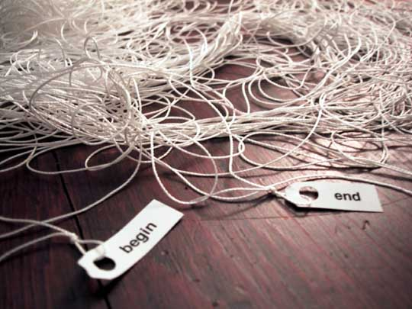
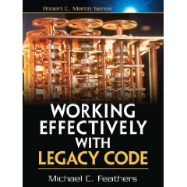
Legacy Code
We don’t always start with a clean sheet of paper.
“Our summer student put this together – can you make these changes …”
Sometimes ‘tactical’ becomes ‘strategic’
“This tool is essential to the platform – we need you to fix it!”
We never stop learning.
“It’s about that system you wrote 6 years ago …”
Working Effectively with Legacy Code (Michael Feathers)

Slide 3
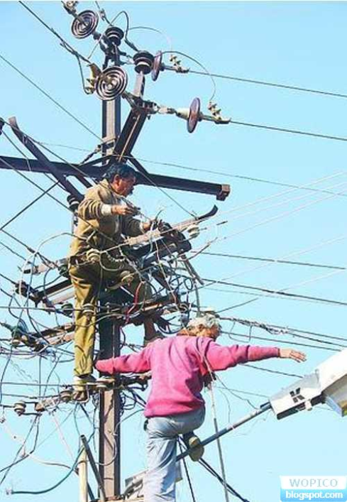
Risky Business
Some jobs are safer than others
How do I make my life a little safer?
Is it worth the cost?

Slide 4

The Cost Of Change
Changing unknown code can be a leap of faith
I want to make it cleaner, but how do I know I won’t break it?
… and I’m certain I’ll be back again next month
For my next trick, I will require the use of a safety net

Slide 5
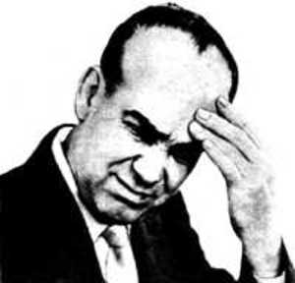
Weaving the net
Find the code you need to change
Get it to compile on it’s own (no collaborators)
May need mocks, stubs or language tricks
Guess a behaviour and capture with an assertion
Characterisation tests
Repeat guess and test for happy and sad paths
Coverage tools can help

Slide 6
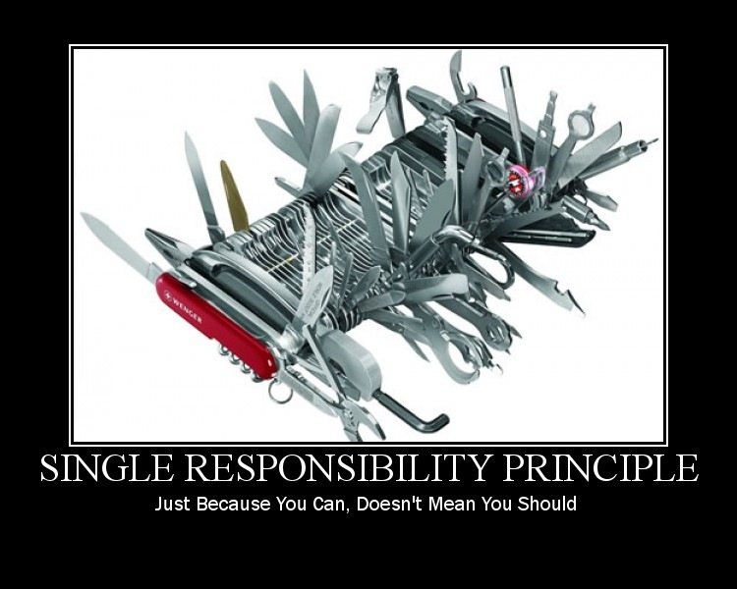
An Example

Slide 7
Overview
public class XMLSender {
XMLSender(Logger logger, String text, String messageID, String senderflag) {
this.logger = logger;
serviceProvider = JNDILookup.getInstance();
sendMessage(text, messageID, senderflag);
}
public void sendMessage(String text, String messageID, String senderflag) {
try {
queueConnectionFactory = serviceProvider
.getQueueConnectionFactory(MessageDrivenBean.JMS_FACTORY);
if (senderflag.equals("REDIRECT")) {
queue = serviceProvider.getQueue(MessageDrivenBean.REDIRECT_QUEUE);
}
else {
queue = serviceProvider.getQueue(MessageDrivenBean.RESPONSE_QUEUE);
}
queueConnection = queueConnectionFactory.createQueueConnection();
queueSession = queueConnection.createQueueSession(false,
Session.AUTO_ACKNOWLEDGE);
...
textMessage.setText(text);
textMessage.setStringProperty("messageId", messageID);
queueConnection.start();
queueSender.send(textMessage);
queueSession.close();
queueConnection.close();
}
catch (Exception e) {
logger.info("Unable to send message to the Queue",e);
MessageDrivenBean.sendMail(e.getMessage());
}
finally {
// Clean up
...
}
}
}

Slide 8
Constructor Challenges
Call-out to static factory method
XMLSender(Logger logger, String text, String messageID, String senderflag) {
this.logger = logger;
serviceProvider = JNDILookup.getInstance();
sendMessage(text, messageID, senderflag);
}
Call the business-logic method during construction
XMLSender(Logger logger, String text, String messageID, String senderflag) {
this.logger = logger;
serviceProvider = JNDILookup.getInstance();
sendMessage(text, messageID, senderflag);
}

Slide 9
Testing the Constructor
Create a subclass and override the business logic method
public class StubbedXMLSender extends XMLSender {
public static boolean wasSendMessageCalled = false;
StubbedXMLSender(Logger logger, String text, String messageID, String senderflag) {
super(logger, text, messageID, senderflag);
}
/*
* Override the sendMessage() method to allow the constructor to be tested
* on it's own
*/
@Override
public void sendMessage(String text, String messageID, String senderflag) {
wasSendMessageCalled = true;
}
}
Instantiate the subclass and assert using the sensing variable.
(The static factory method is still called though)
@Test
public void shouldBeAbleToInstantiateAnXMLSender() {
new StubbedXMLSender(null, null, null, null);
assertTrue(StubbedXMLSender.wasSendMessageCalled);
}

Slide 10
Business Logic
Switch on parameters
if (senderflag.equals("REDIRECT")) {
queue = serviceProvider.getQueue(MessageDrivenBean.REDIRECT_QUEUE);
}
else {
queue = serviceProvider.getQueue(MessageDrivenBean.RESPONSE_QUEUE);
}
Some boilerplate, and some real logic
queueConnection = queueConnectionFactory.createQueueConnection();
queueSession = queueConnection.createQueueSession(false,
Session.AUTO_ACKNOWLEDGE);
...
textMessage.setText(text);
textMessage.setStringProperty("messageId", messageID);
queueConnection.start();
queueSender.send(textMessage);
Error handling
catch (Exception e) {
logger.info("Unable to send message to the Queue",e);
MessageDrivenBean.sendMail(e.getMessage());
}

Slide 11
Testing the Business Logic
Mocks + Stubs
EasyMock
PowerMock
Mock constructors and static methods
The sledgehammer – great for breaking-up hard dependencies, a sign of problems if used for everyday jobs.
Treat test code like production code
Refactor duplication out
Keep tests small and focus
Characterisation tests != unit tests
Trying to capture existing behaviour
Expect to have to do more work
Use test-coverage tools to look for missed behaviour

Slide 12

And the payback is …
With my tests is place I can
Make these changes, and the next ones, and the next ones
Refactor
Add assertions to my build to stop the coverage from falling

Slide 13
